Slide 1

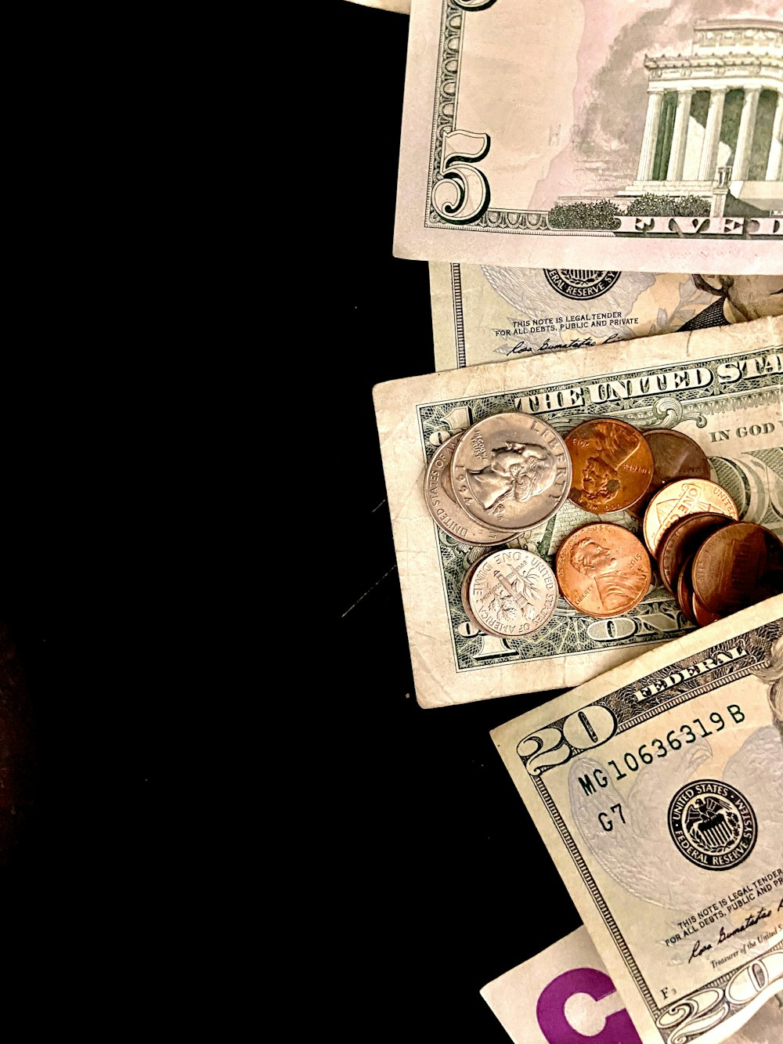
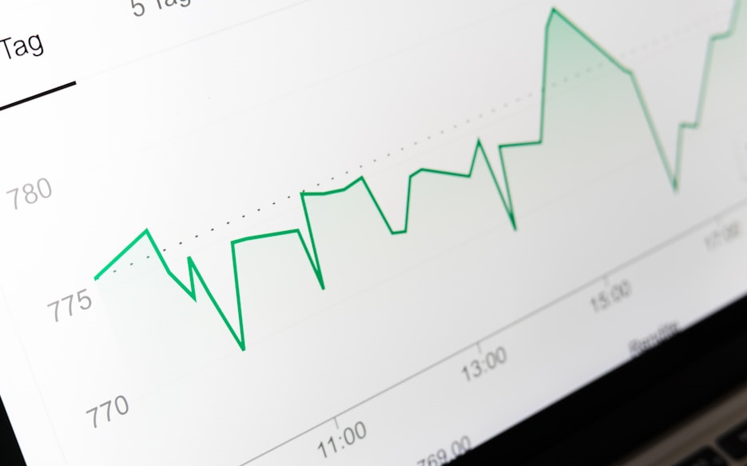
4483/8995 Capstone Project Presentation
Cellphone Price Production
Charlotte Burrows – u3284174
Tutorial: Wednesday 2:30

Slide 2
Table of Contents
Overview
Dataset Details
EDA (Exploratory Data Analysis) Outcomes
AI/ML/PDA (Predictive Data Analytics) Outcomes
Implementation and Deployment of the GUI
References/Bibliography

Slide 3
Overview
Problem Statement: This project aims to predict cell phone prices by:
Analysing & Creating
Numerical data
Pictorial data
Building models
Model testing & training
Self-developed model
For end-users to interact with.

Slide 4
2. Dataset Details
Product Id - ID of each cellphone
Price - Price of each cellphone
Sale - Sales number
Weight - Weight of each cellphone
Resolution - Resolution of each cellphone
PPI - Phone Pixel Density
CPU core - type of CPU core in each cellphone
CPU frequency - CPU Frequency in each cellphone in Hertz (Hz)
internal memory - Internal memory of each cellphone both read-only memory (ROM) and random-access memory (RAM)
Ram - Random-Access Memory of each cellphone
Rear Camera - The camera is located on the back of a device.
Front Camera - The camera is located on the front of a device.
battery - The power source for electronic devices
thickness - The measurement of how thin or thick a device.

Slide 5
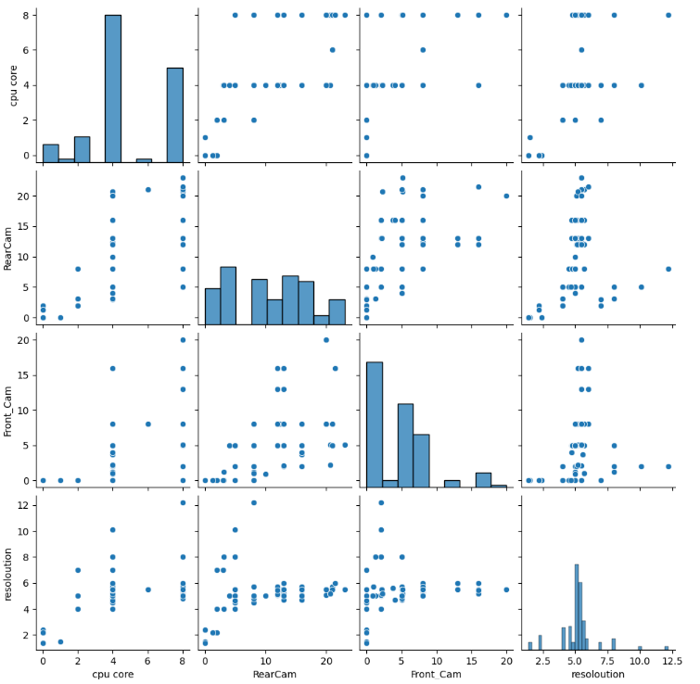
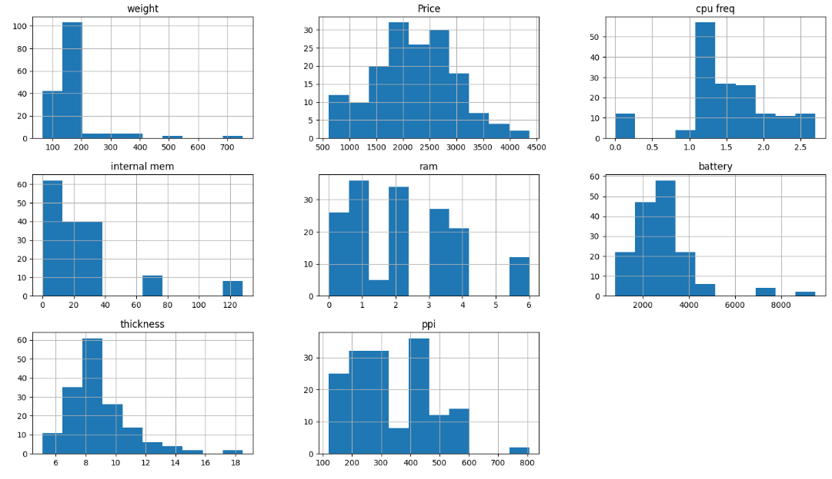
3. EDA (Exploratory Data Analysis) Outcomes
Categorical Data
Continuous Data

Slide 6
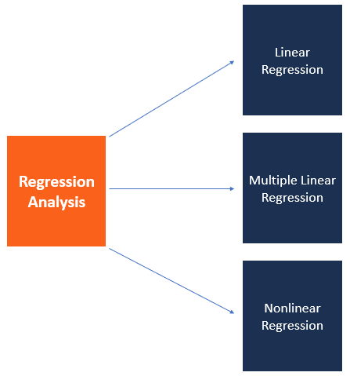
4. AI/ML/PDA (Predictive Data Analysis) Outcomes
Highest production rate: xgbost Regression
“Regression analysis is a set of statistical methods used for the estimation of relationships between a dependent variable and one or more independent variables.“
(“Regression Analysis”)

Slide 7
5. Implementation and Deployment of the GUI

Slide 8
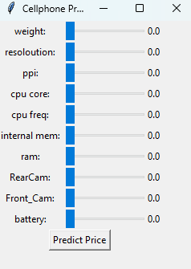
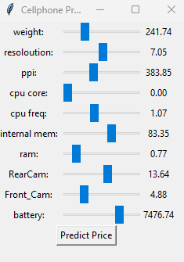
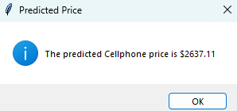
Cellphone Price Predictor

Slide 9
REFLECTION
Individual project
Allowing for a more in-depth investigation into data analysis

Slide 10
References /Bibliography
GitHub. “GitHub.” GitHub, 2024, github.com/.
“Google Colab.” Colab.research.google.com, colab.research.google.com/drive/1Tld9V15g4gggja8fdt520CFG_NBt3Hxr#scrollTo=R6IjxlR_Ulte. Accessed 30 Apr. 2024.
“Regression Analysis.” Corporate Finance Institute, corporatefinanceinstitute.com/resources/data-science/regression-analysis/#:~:text=Regression%20analysis%20is%20a%20set%20of%20statistical%20methods.
Unsplash. “Photo by Aarush Kochar on Unsplash.” Unsplash.com, 25 July 2020, unsplash.com/photos/10-and-20-us-dollar-bill-ZmLXBRfjSpo. Accessed 30 Apr. 2024.
---. “Photo by Markus Winkler on Unsplash.” Unsplash.com, 9 June 2020, unsplash.com/photos/black-and-silver-laptop-computer-IrRbSND5EUc.

